Slide 1
La conciergerie
Olivia Walker | Skye Dinko
April 8, 2015

Slide 2
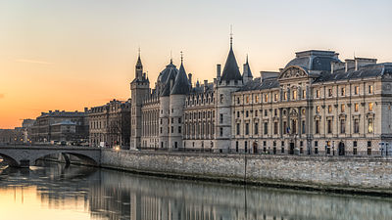
La Conciergerie
It is located in Paris, France, on the west of the Île de la Cité or the Island of the City.
It is the oldest remaining part of the Palais de la Cité a Merovingian Palace,which consisted of la Conciergerie Palais de Justice and the Sainte-Chapelle.
Became a prison in 1391.
Also was the first royal palace in the French capital that was used as a prison during the French Revolution.
It is mostly known for being a prison during the reign of terror in France.
Also having housed Marie Antoinette as a prisoner until she was guillotined.

Slide 3
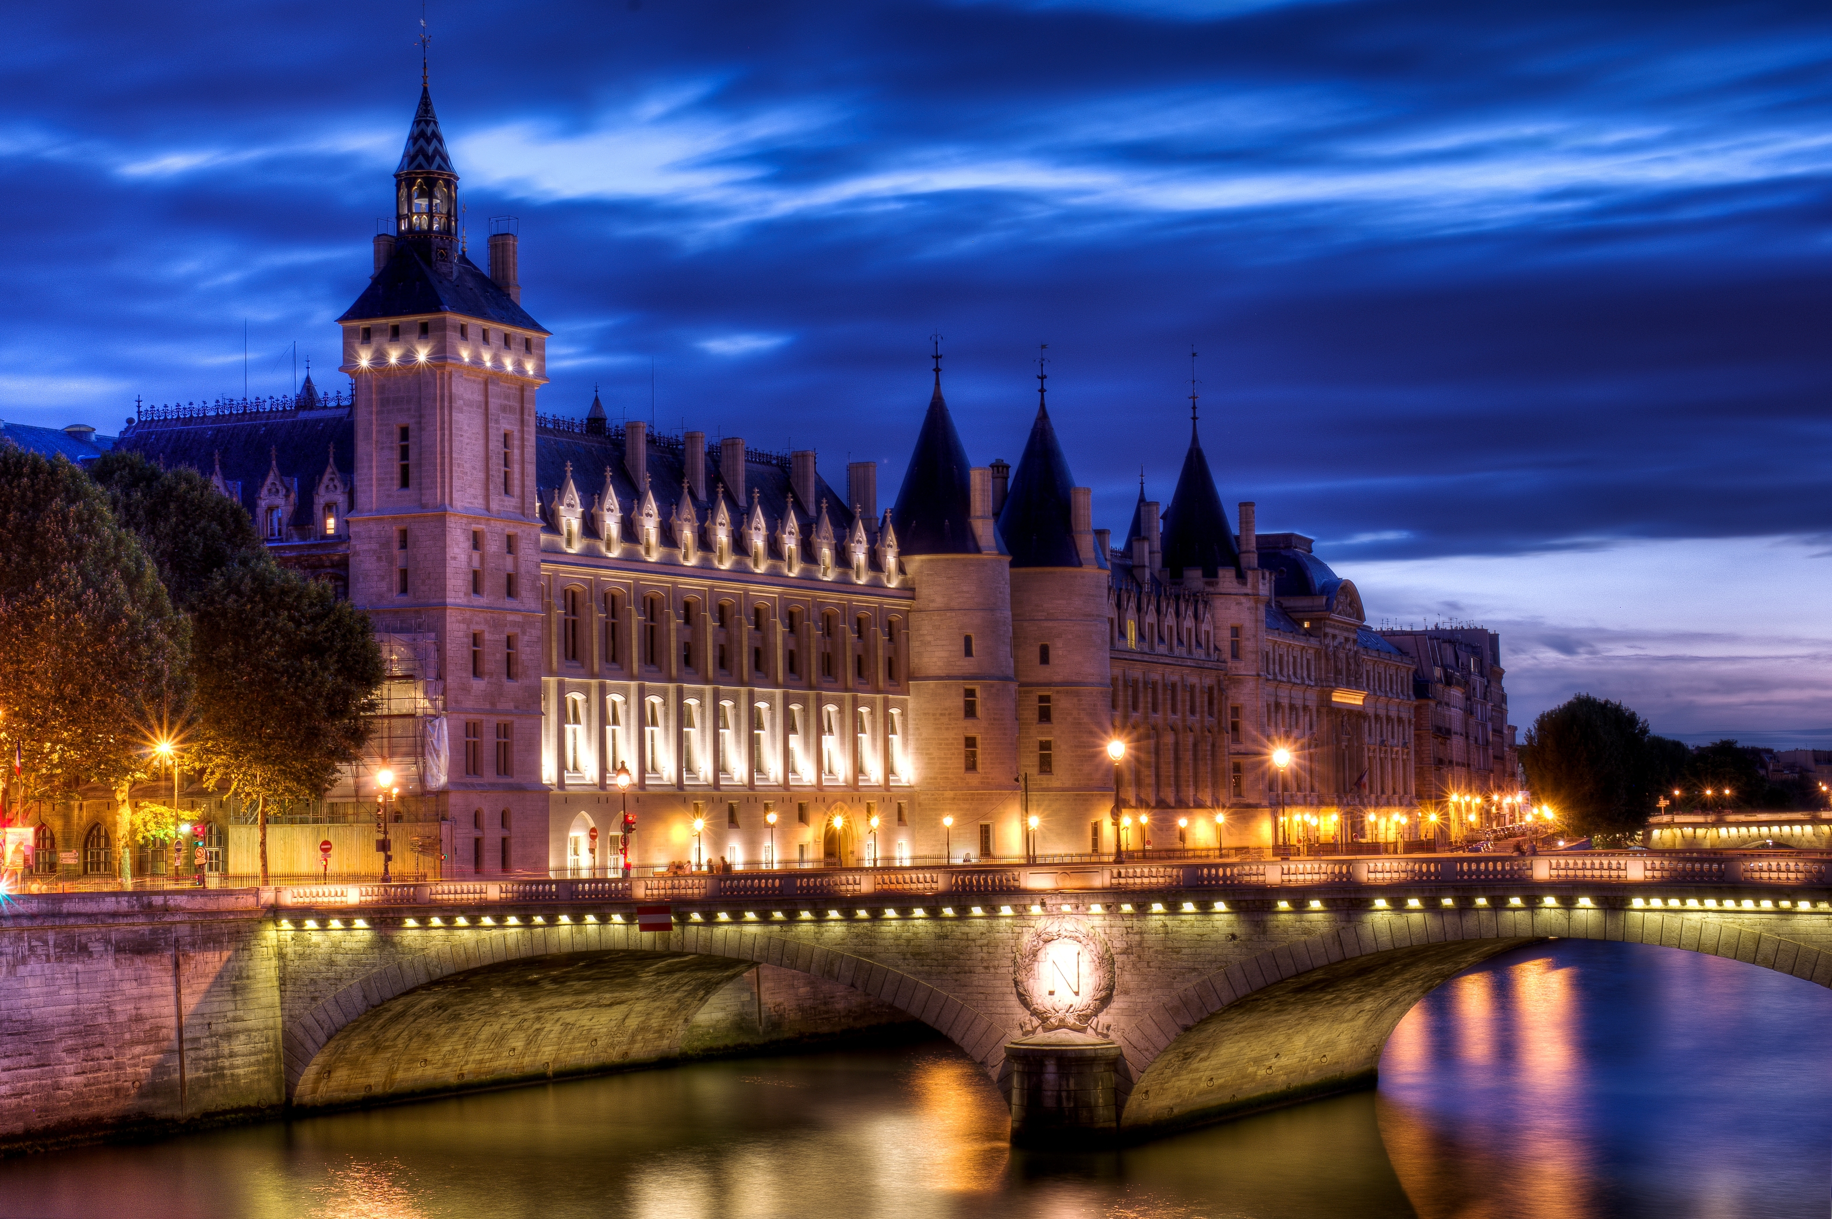
La Conciergerie
The Conciergerie was decommissioned in 1914
It was opened to the public as a national historical monument
The architects were Salomon de Brosse & Jacques V Gabriel
Rib vault Chateau

Slide 4
La Conciergerie
The west part of Ile de la Cité island was known as the Palais de la Cité.
From the 10th to the 14th centuries it was the seat of the medieval Kings of France. Louis IX from 1214–1270 and Philip IV 1284–1314.
It was extended and more heavily fortified. by Philip IV, grandson of Louis IX had the palace on the Île de la Cité remodeled and extended.
Around 1350, King John added on kitchens and the clock tower.
The early kings continued to improve the palace in the 14th century, but it was abandoned by Charles in 1358. When he decided to move to the Louvre.
The palace continued to serve an administrative function, and still included the chancellery and French Parliament.
In the king's absence, he appointed a concierge to hold command of the palace.

Slide 5
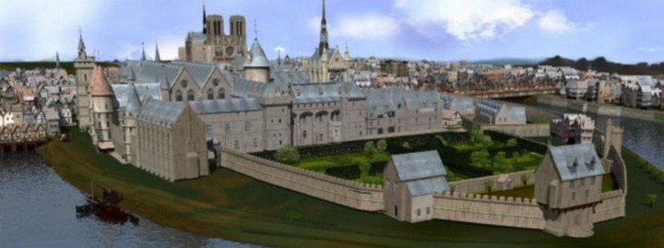
La Conciergerie
“The Conciergerie" was given over to the Parliament to be used for the kingdom's administrative offices. The care of the palace was left to a gentleman known as the Concierge the man who had legal and police authority in the city. The name stuck and it became known as La Conciergerie
This was a very high ranking office, and could be considered the housekeeper for the king. In 1391 part of the building was converted for use as a prison, and took its name from the ruling office.

Slide 6
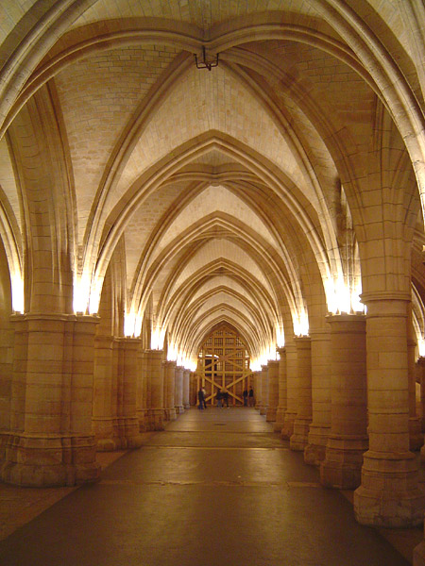
La Buildings Remaining From The Middle Ages
Hall of the men at arms is one of the oldest surviving parts of La Conciergerie from the middle ages.
An example of lay Gothic architecture that is still in existence from the middle ages.
Has a barrel vaulted ceiling and huge columns all around.
The surviving parts are 64m long, 27.5m wide and 8.5m high. It was used as a dining-room for the 2,000 staff members who worked in the palace. It was built by Enguerrand de Marigny between 1302 and 1313
It was heated with four large fireplaces and lit by many windows, now blocked up. It was also used for royal banquets and judicial proceedings.

Slide 7
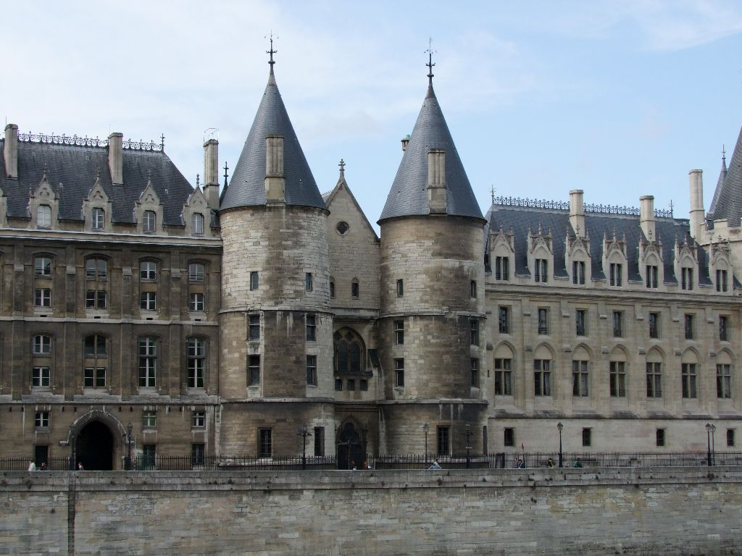
Buildings Remaining from the Middle Ages
Three towers survived
The Caesar Tower- which was named in honor of the Roman Emperors
The Silver Tower- was named for its use as the store for the royal treasure though not proven
Bonbec Tower-which means good beak which obtained its name from the torture chamber that it housed, in which victims were encouraged to "sing".

Slide 8
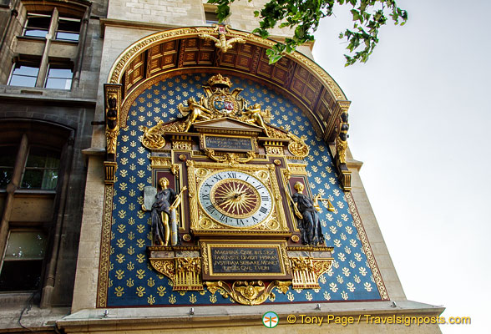
Clock TOwer
Added on By King John at the North-East corner of the palace, it is a rectangular lookout tower, called the Clock Tower, because the country's first public clock was installed it dates back to the1350s.
In 1585, this clock was replaced by one created by Germain Pilon.
It has a blue background with gold designs
Also has a multi colored face and framed with allegories of the Law and Justice is still in place.

Slide 9
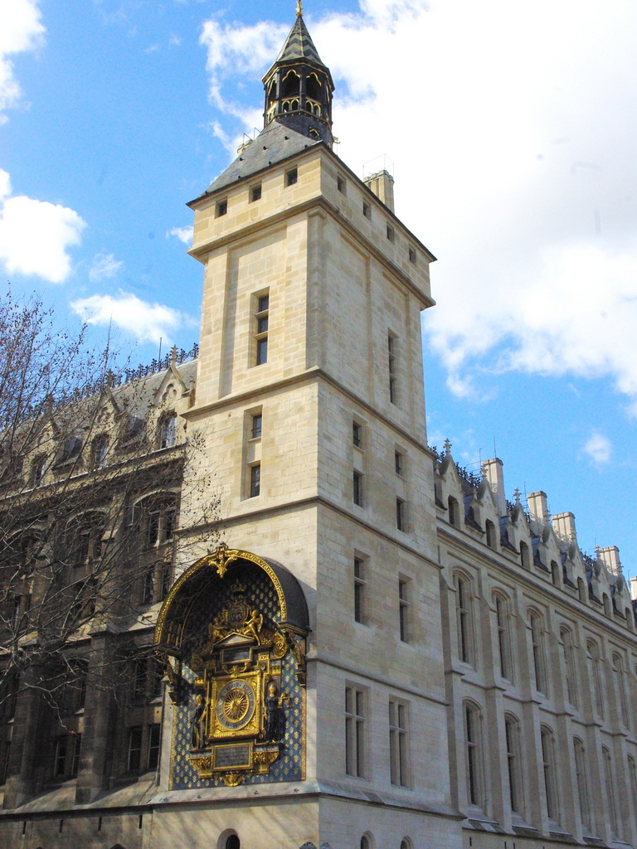
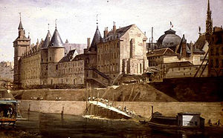

Slide 10
Facts of the Reign of Terror (1793-1794)
40,000 people died from execution and imprisonment
Two fates for those that sent before tribunal
1. acquittal
2. death
Tribunal sent 2,600 prisoners to the guillotine between 1793 and 1795
Prisoners were placed in room according to wealth
Wealthier prisoners could rent a bed fro 27 livres (36 euros) for the 1st month
Only celebrity prisoners got cells to themselves
Most low-income prisoners were stuffed into single rooms making disease inevitable (rats & urine)

Slide 11
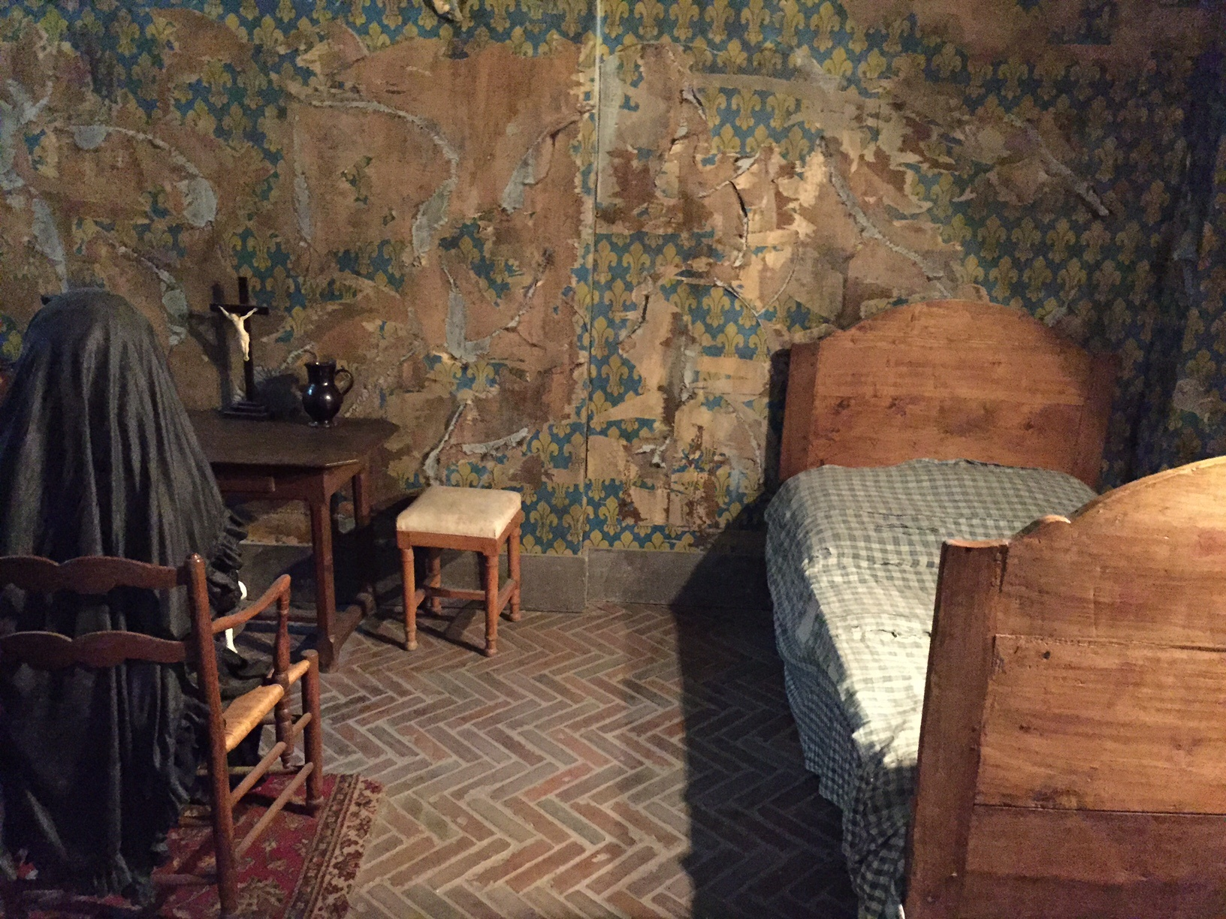
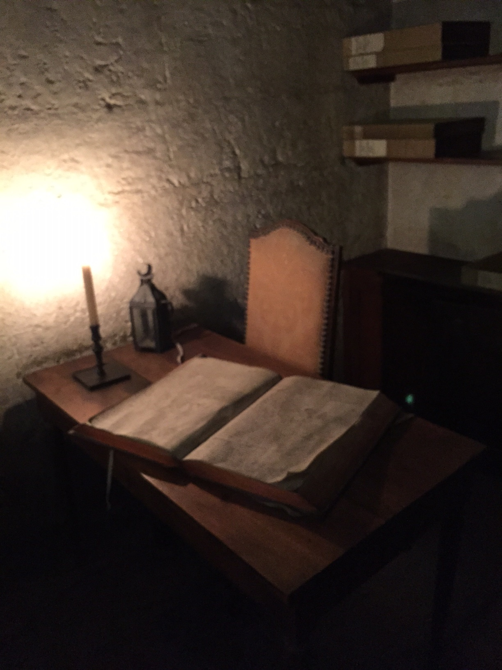
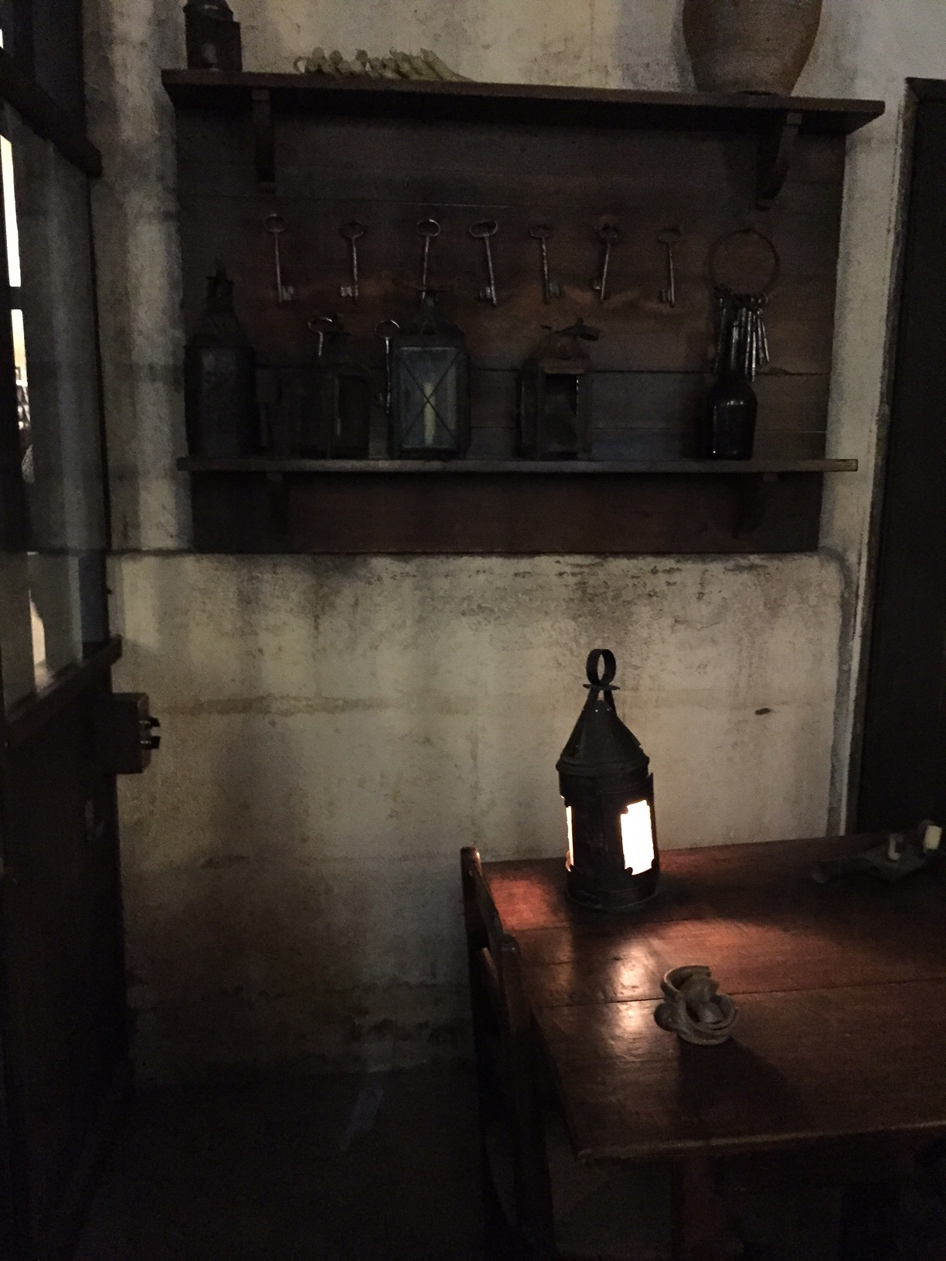
Marie Antoinette's Jail Cell

Slide 12
Merci Beaucoup

